Slide 1

FLASHCODE
SMART MINDS. FAST ANSWERS. ZERO JUDGMENT.
TEAM DELTA

Slide 2

PROBLEM STATEMENT AND SOLUTION
Finding reliable help takes too long.
Books and online tools aren’t always quick or useful.
Relying only on AI makes learning less engaging.
FlashCode - a platform where Students can ask, answer, and learn together.
Boosts learning through voting, sharing, and teamwork.
It creates a community that helps solve problems better together.

Slide 3


TECHSTACK
Frontend & Styling
Next.js, TypeScript, Tailwind CSS, ShadCN
Authentication & Forms
Clerk, NextAuth.js, React Hook Form
Backend
Next.js API , Flask, MongoDB, Mongoose
Notes:
3

Slide 4
FEATURES
01
04
Search, Save, Interact, and Explore Kent State Events
Secure authentication
02
Responsive design with Light/Dark mode
05
Detailed user profiles with activity tracking
03
06
Tech blog and Daily coding challenges for skill Improvement
Q&A system with voting and filtering
Notes:
3

Slide 5
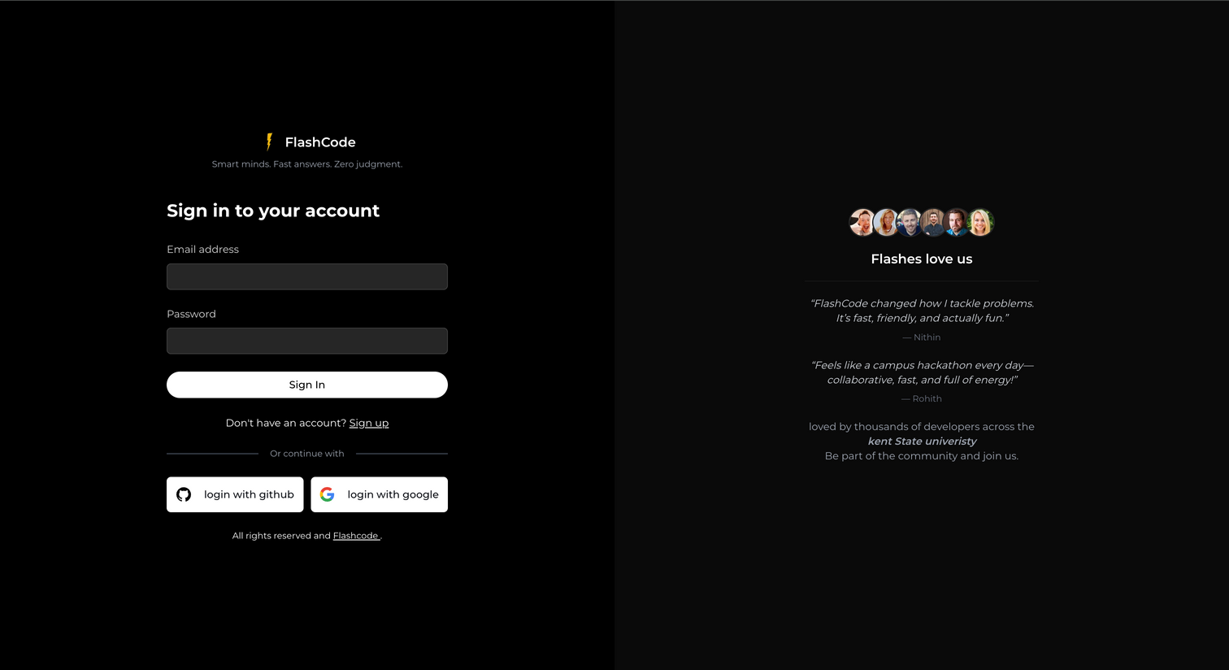
GUEST ACCESS / LOGIN ACCESS
Browse questions.
See Events.
Read Articles.
Post questions & answers.
Vote and comment.
Save questions to Collections.

Slide 6
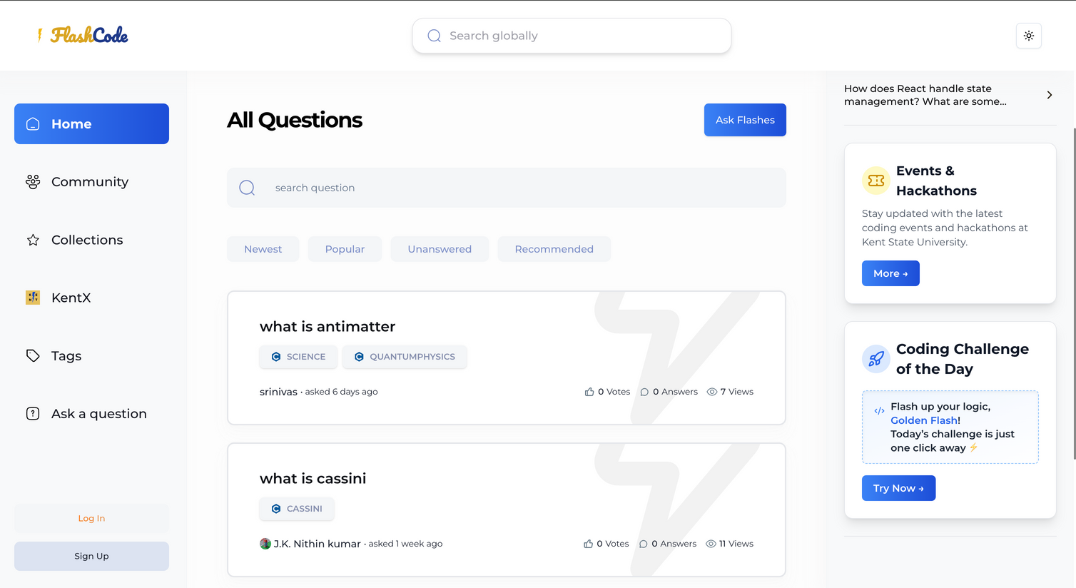
HOMEPAGE
View question cards with votes & answers.
Local & global search options.
Easy navigation via sidebars (left & right).
Filter By Tags.

Slide 7

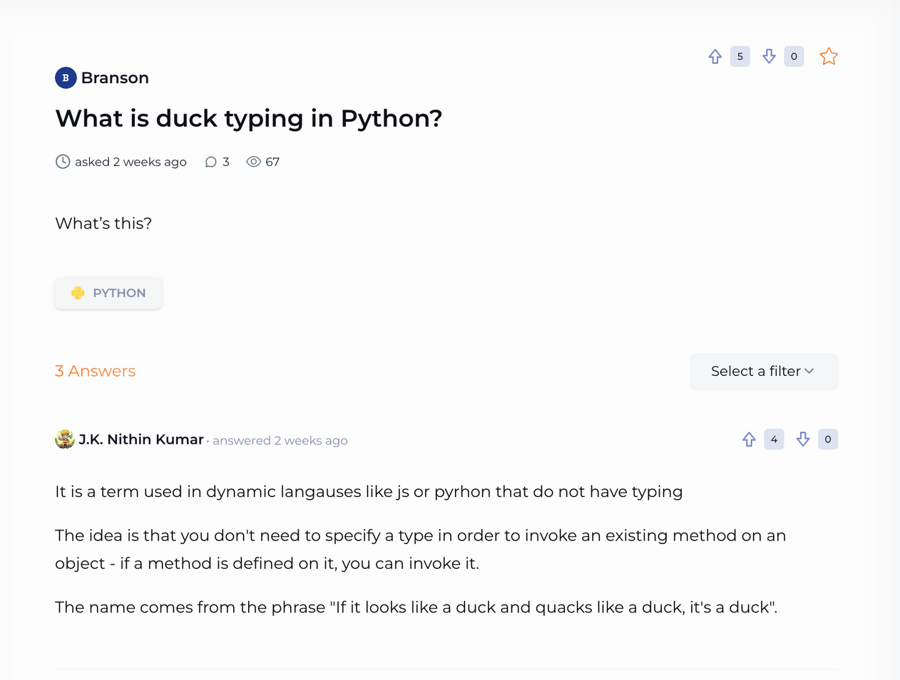
QUESTION DETAILS
View full question & answers.
Post your answer.
Vote on helpful answers.
Filter answers (e.g., most recent, most upvoted)
Pagination for smooth performance.
Notes:
7

Slide 8
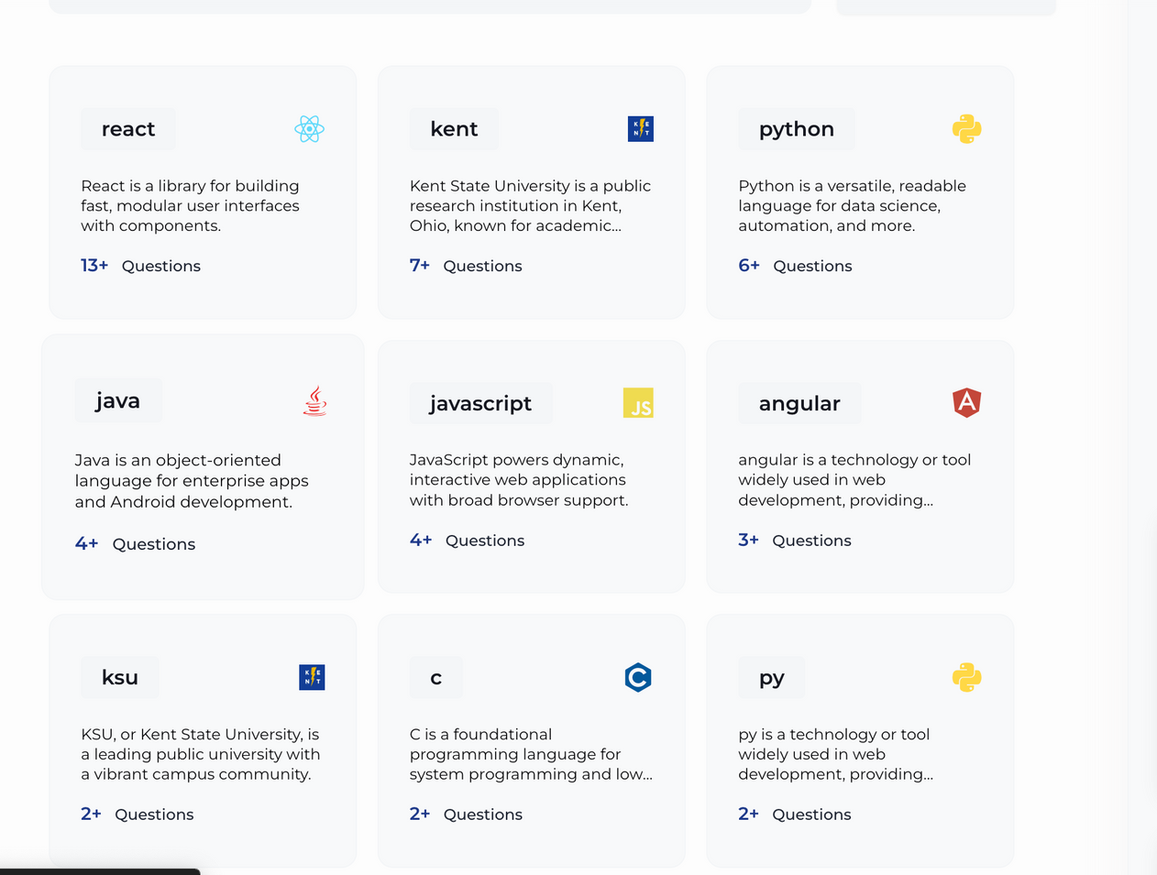
EXPLORE & ORGANIZE
Community
View user profiles.
Filter & search users by name.
Collections
Save important questions.
Organize with filters & search.
Tags
Browse questions by topics.
Use filters to find relevant posts.

Slide 9
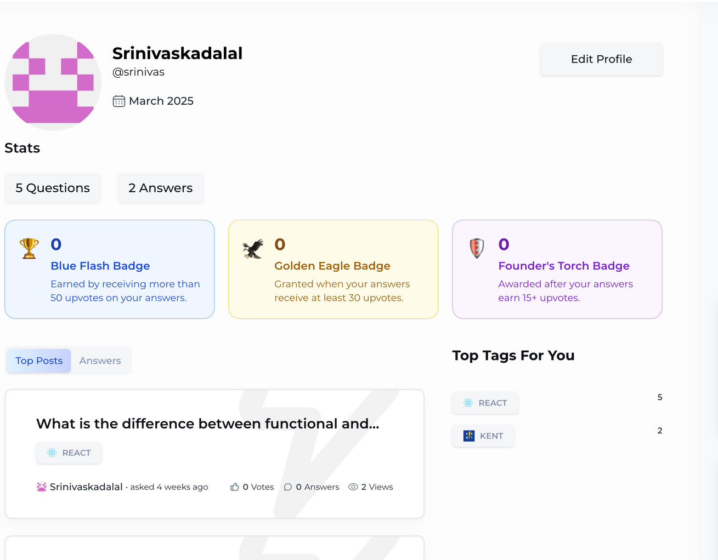
EXPLORE & ORGANIZE
Profile Page
View/edit user info
Track badges, top posts & activity
Ask a Question
Add title, detailed description
Tag the question & submit
Tech Blogs
Filter/sort by category
Read full tech articles

Slide 10
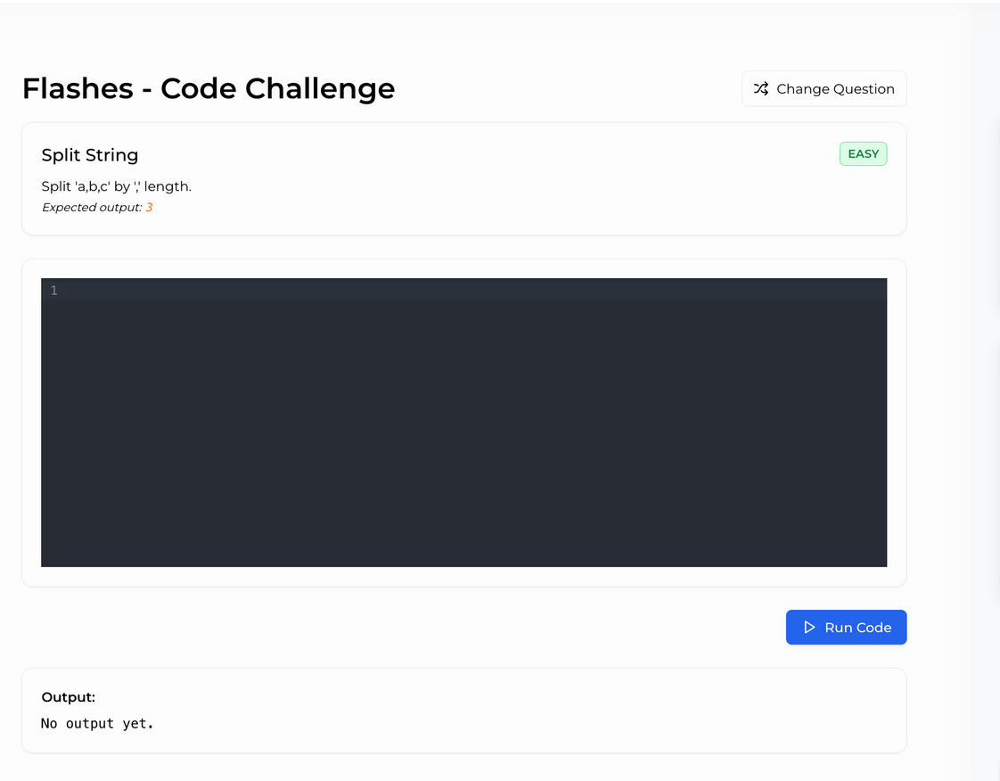
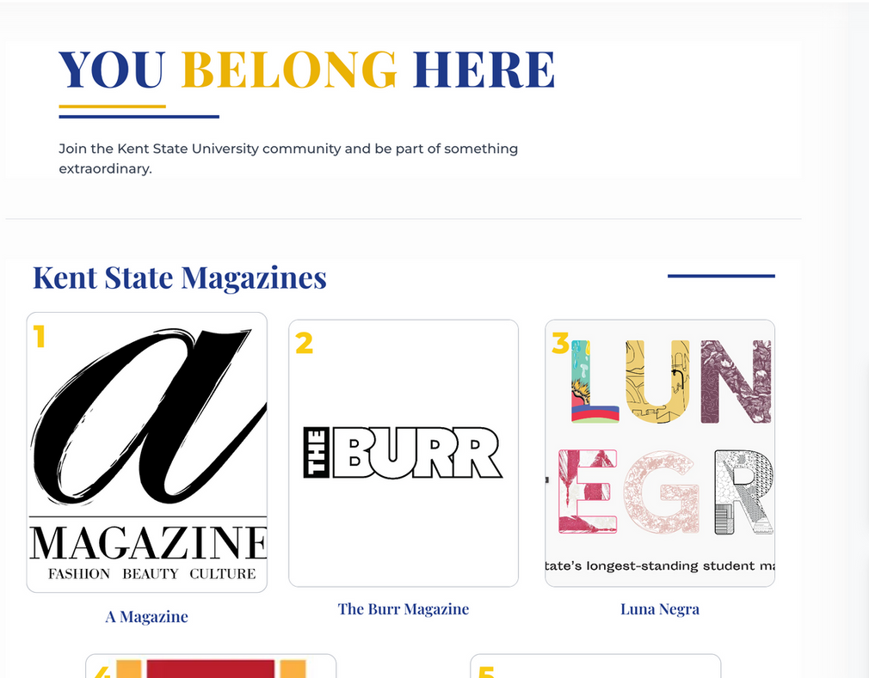
CODE CHALLENGE & KENTX
Coding challenge
Kent State magazines, important dates, merchandise
Notes:
10

Slide 11

ADMIN DASHBOARD
Manage users: view, edit, delete, track activity
View analytics: questions, answers, and engagement trends
Get insights on question performance (upvotes, answers, etc.)
Manage tags: add, edit, and track usage
Handle events & magazines: add, update, delete
Configure app settings: roles, security, privacy
Use Clerk for role-based access and authentication

Slide 12
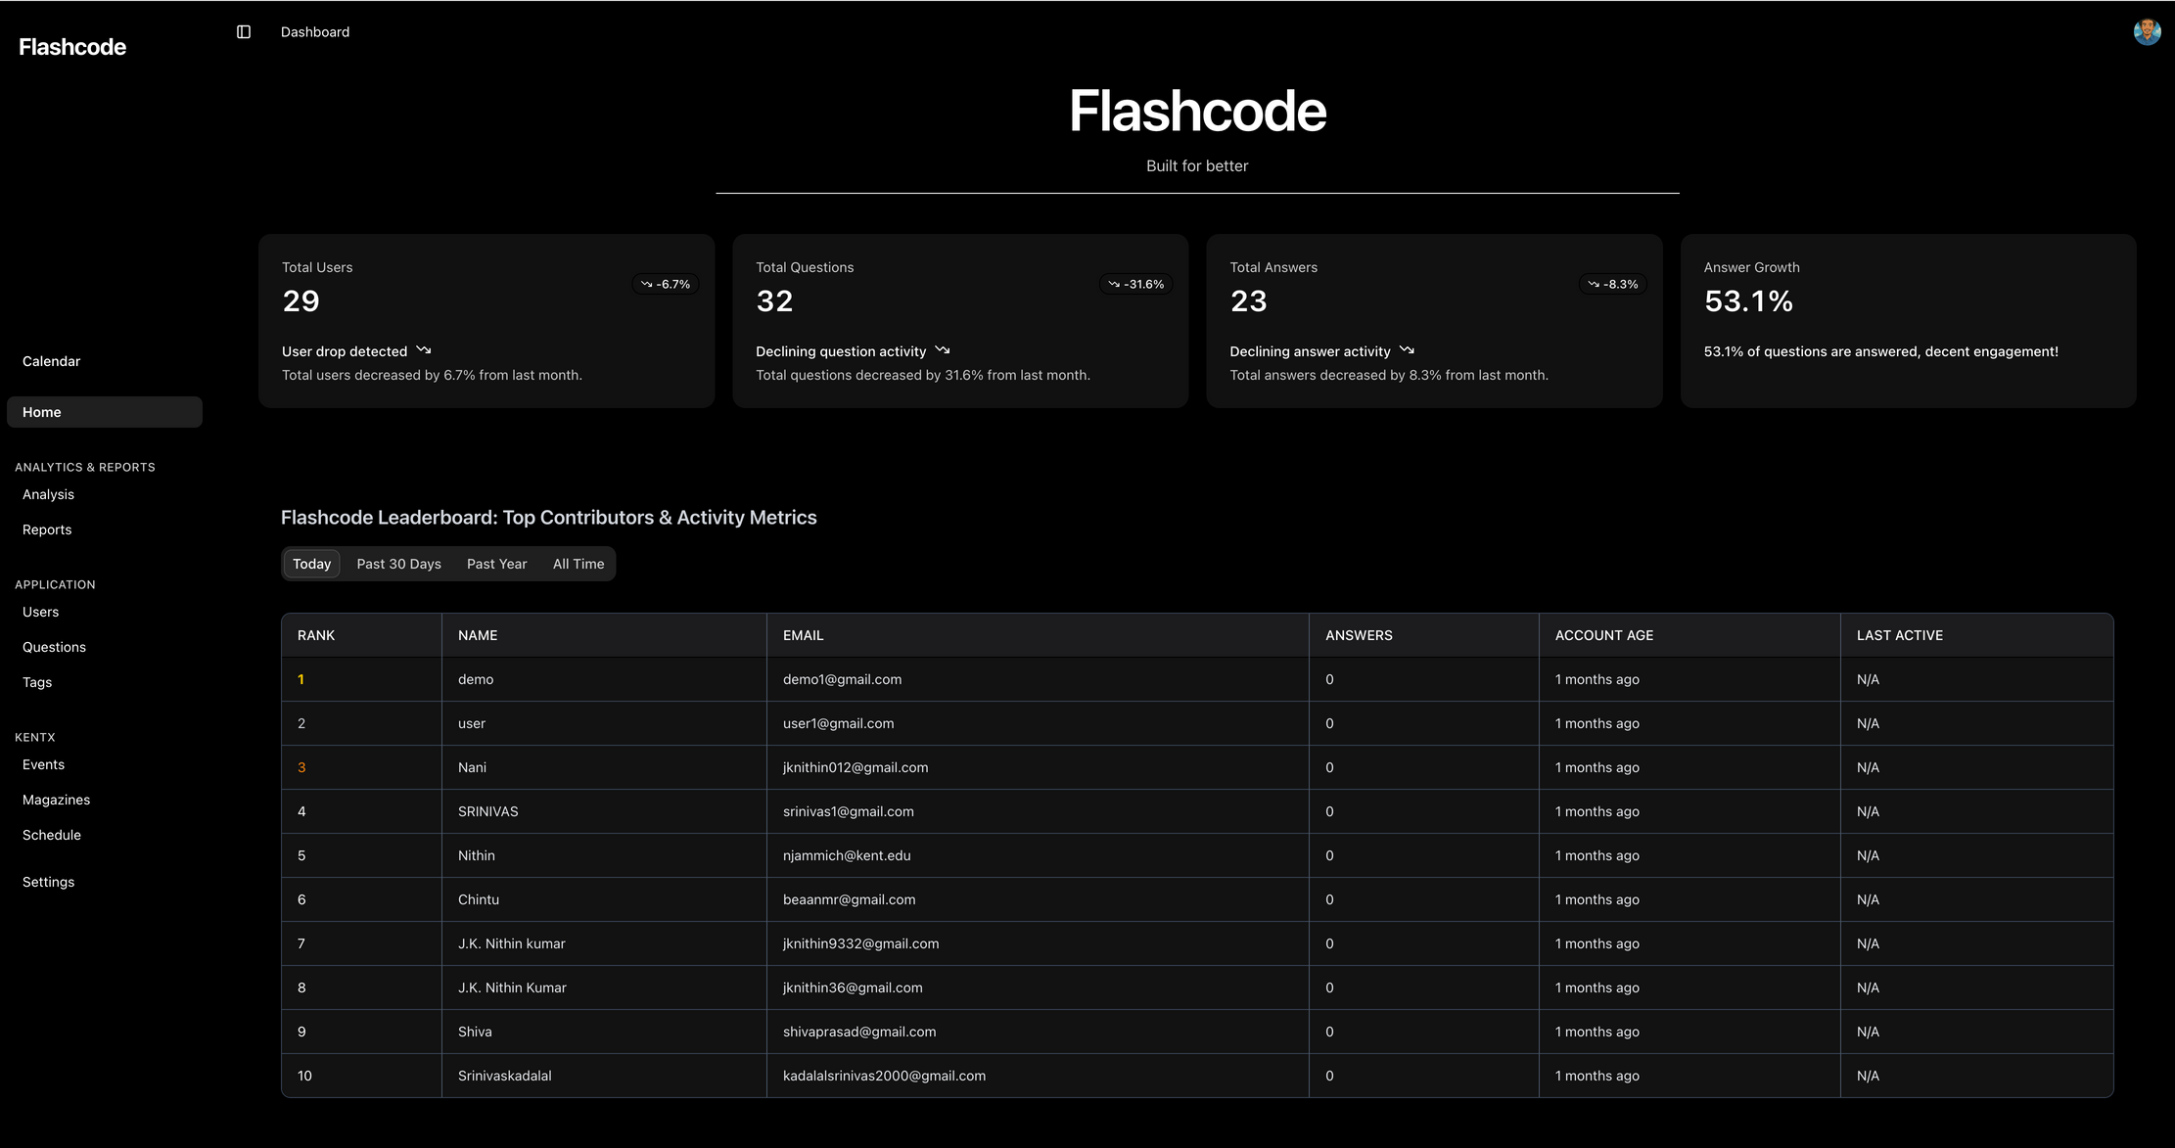
ADMIN DASHBOARD

Slide 13
FUTURE WORK
01
05
Chat Feature
Connections: Follow others to build networks
02
06
Mobile App: Stay connected on the go
Share files
03
07
Event ads & sports rankings
Comments: Discuss and clarify answers
04
08
Project Builder for student ideas
Stories: Share experiences and tips

Slide 14

CONCLUSION
FlashCode empowers students to learn, connect, and grow through collaboration. With KentX and future features, it’s more than a platform—it’s a campus companion. Together, we’re building a smarter, stronger student community.
Thanks to
Professors Gregory S. DeLozier and Branson Boggia
Kudos to Team Delta and all classmates—great projects, great teamwork
Team Delta

Slide 15


